Slide 1
University Database
Krishna vardhini K

Slide 2
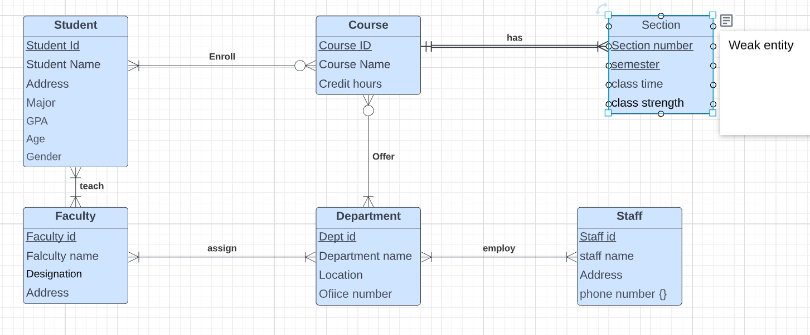
EERD of University

Slide 3
METADATA :
Entity : Student_1
Attributes | Datatype | Description | Required/Optional
Student Id | char(4) | Student Id with alpha numeric charaters (primary key) | Required
Student Name | varchar(20) | Student first name and last name | Required
Address | varchar(50) | Student address | Required
Major | char(10) | Student Major of the degree | Required
GPA | double(4) | Average Grade details | optional
Age | int(2) | Age of the student | Required
Gender | char(6) | Male or female | Required
Entity : Course
Attributes | Datatype | Description | Required/Optional
Course Id | char | Course Id as alpha numeric character(primary key) | Required
Course Name | varchar(10) | course name as variable character | Required
Course Hours | time(8) | Course time window in hours | Required
Entity : Section
Attributes | Datatype | Description | Required/Optional
Section number | char(2) | Section number of the course as identifying key | Required
semester | char(2) | semester details (fall/spring/summer) as identifying key | Required
class time | time(8) | Section time window | Required
class strength | int(2) | Total strength of each section | optional
Entity : Faculty
Attributes | Datatype | Description | Required/Optional
Faculty Id | int(5) | Faculty Id in numbers(primary Key) | Required
Faculty Name | varchar(15) | Faculty first name and last name | Required
Designation | char(15) | Designation of the faculty | Required
Address | varchar(20) | Address of the faculty | Required
Entity : Department
Attributes | Datatype | Description | Required/Optional
Dept id | char(5) | Department Id(primary key) | Required
Department Name | char(10) | Department Name | Required
Location | varchar(15) | Department building name | Required
Office Number | int(10) | Office phone number with extension number | Required
Entity : Staff
Attributes | Datatype | Description | Required/Optional
Staff Id | char(5) | staff member id (primary key) | Required
Staff name | varchar(15) | staff member name | Required
Address | varchar(20) | Address of the staff member | Required
Phone number | int(10) | 10 digit phone number | Required

Slide 4
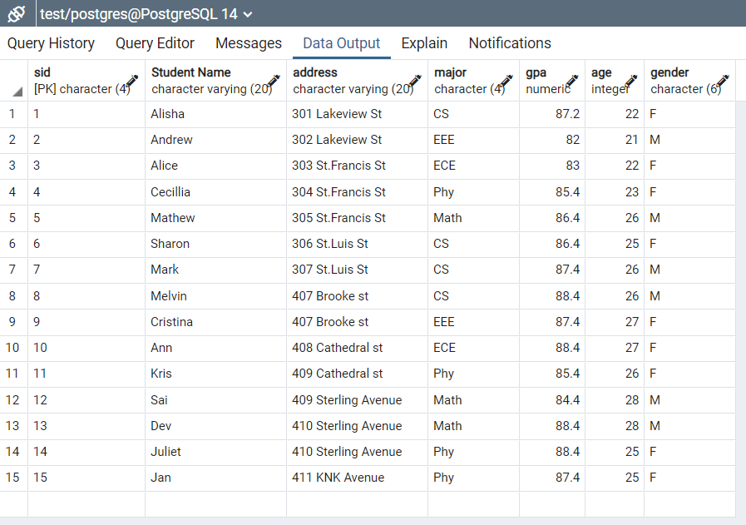
SQL QUERY
Create at least one or two tables of the design. Output:
CREATE TABLE student_1(
Sid char(4) PRIMARY KEY,
"Student Name" varchar(20),
Address varchar(20),
Major char(4),
GPA DECIMAL,
Age int,
Gender char(6));

Slide 5
SQL QUERY
Output:
2. Insert at least 15 tuples (rows) into each table using SQL queries.
INSERT INTO student_1 VALUES (1,'Alisha','301 Lakeview St','CS',87.2, 22,'F');
INSERT INTO student_1 VALUES (2,'Andrew','302 Lakeview St','EEE',82, 21, 'M');
INSERT INTO student_1 VALUES (3,'Alice', '303 St.Francis St','ECE',83,22,'F');
INSERT INTO student_1 VALUES (4,'Cecillia','304 St.Francis St','Phy',85.4,23,'F');
INSERT INTO student_1 VALUES (5,'Mathew','305 St.Francis St','Math', 86.4,26,'M');
INSERT INTO student_1 VALUES (6,'Sharon','306 St.Luis St','CS', 86.4,25,'F');
INSERT INTO student_1 VALUES (7,'Mark', '307 St.Luis St','CS', 87.4,26,'M');
INSERT INTO student_1 VALUES (8,'Melvin', '407 Brooke st','CS', 88.4,26,'M');
INSERT INTO student_1 VALUES (9,'Cristina','407 Brooke st','EEE',87.4,27,'F');
INSERT INTO student_1 VALUES (10,'Ann','408 Cathedral st','ECE',88.4,27,'F');
INSERT INTO student_1 VALUES (11,'Kris','409 Cathedral st','Phy',85.4,26,'F');
INSERT INTO student_1 VALUES (12,'Sai','409 Sterling Avenue','Math',84.4,28,'M');
INSERT INTO student_1 VALUES (13,'Dev','410 Sterling Avenue','Math',88.4,28,'M');
INSERT INTO student_1 VALUES (14,'Juliet','410 Sterling Avenue','Phy',88.4,25,'F');
INSERT INTO student_1 VALUES (15,'Jan','411 KNK Avenue','Phy',87.4,25,'F');

Slide 6
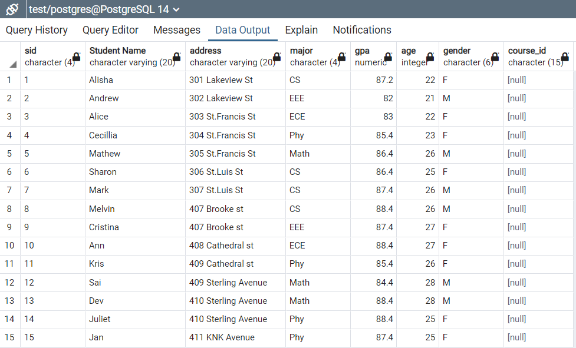
SQL QUERY
3.Modify (add and delete) columns of a table using SQL queries.
ALTER TABLE student_1
ADD Course_id CHAR(15);
Output:

Slide 7
SQL QUERY
4.Delete a column of a table using SQL queries.
ALTER TABLE student_1
DROP COLUMN Course_id;
Output:

Slide 8
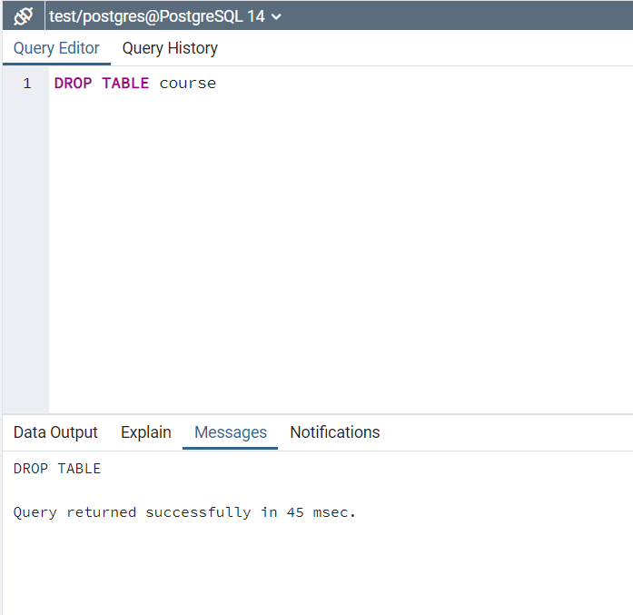
SQL QUERY
Remove one table using SQL queries:

Slide 9
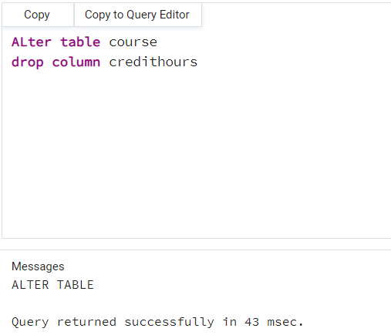
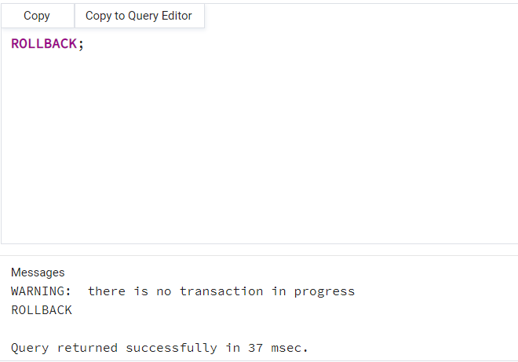
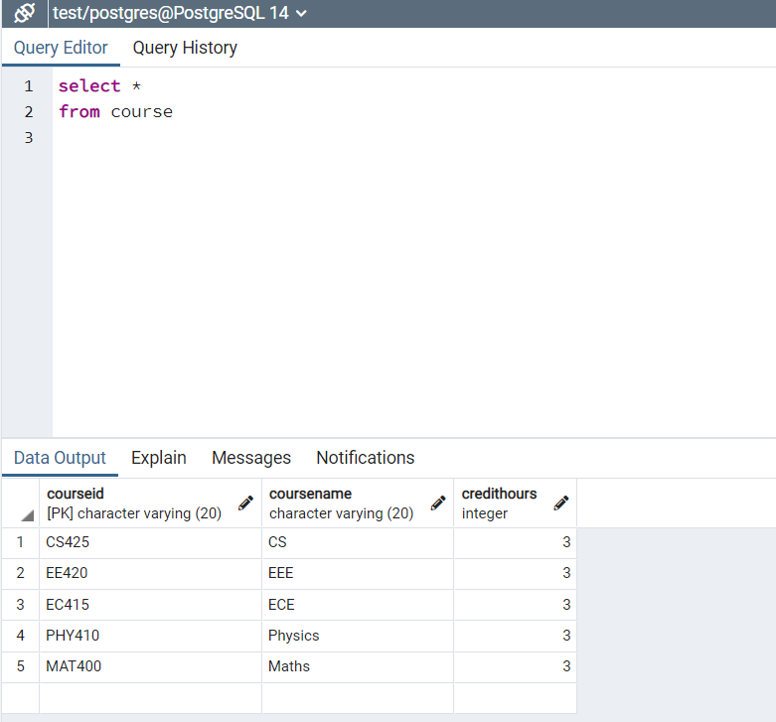
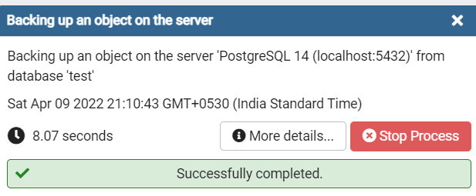
SQL QUERY
Restore the deleted column to the table by item 4 using SQL queries
Restore the removed table by item 6 using SQL queries.

Slide 10
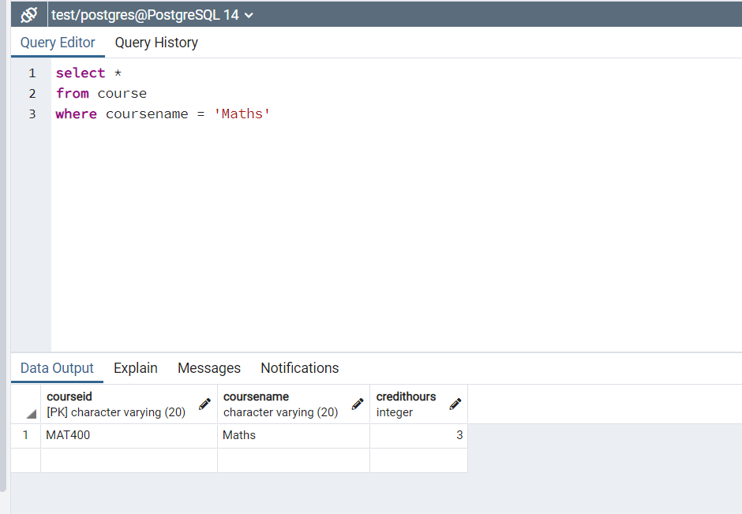
SQL QUERY
Create at least 10 different queries to search data using a table
1)Course details of Maths:
select *
from course
where coursename = 'Maths'

Slide 11
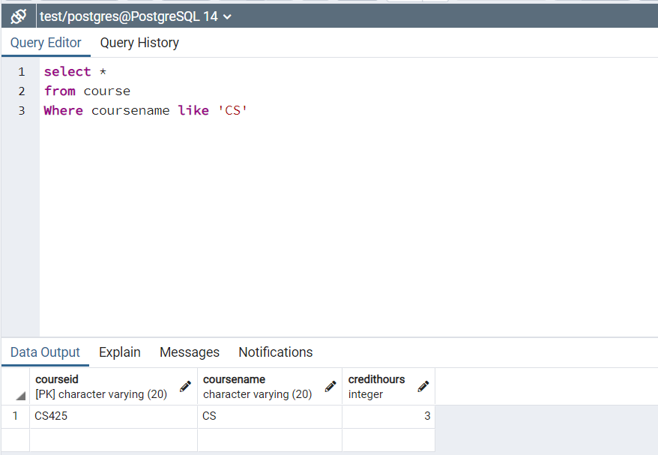
2)course details of ‘CS’:
select *
from course
Where coursename like 'CS'

Slide 12
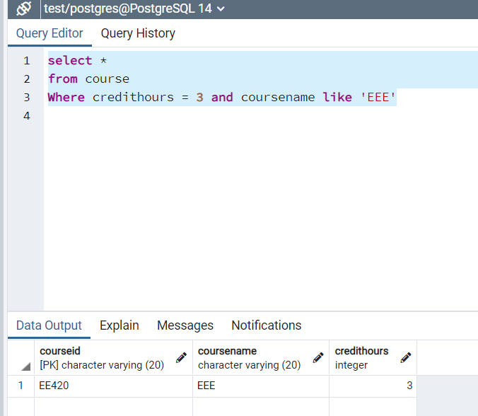
3. Course details of EEE with credit hours 3:
select *
from course
Where credithours = 3 and coursename like 'EEE'

Slide 13
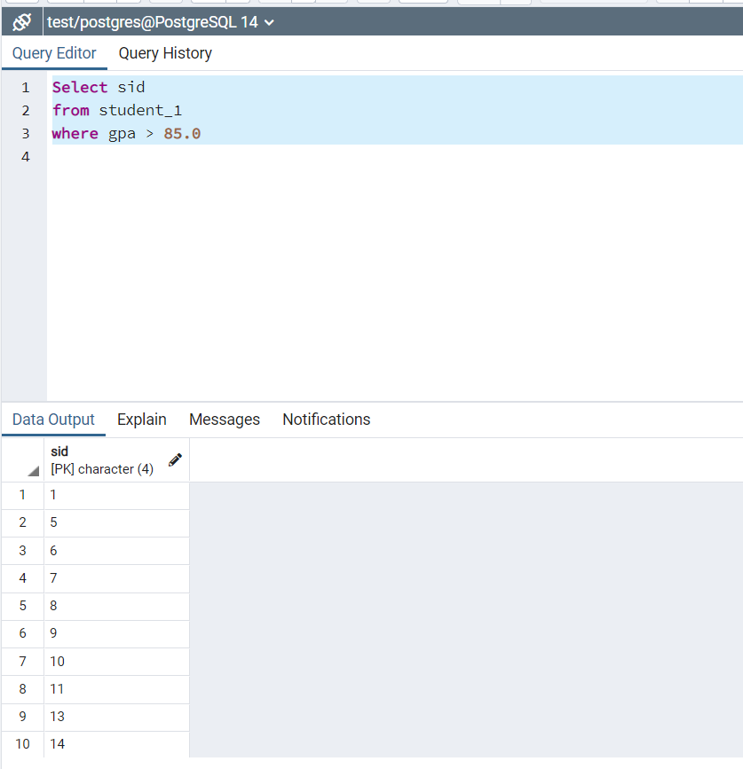
4. Students list whose GPA above 85:
Select sid
from student_1
where gpa > 85.0

Slide 14
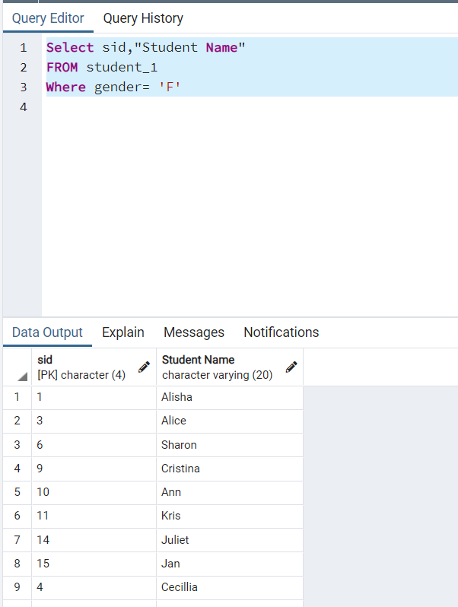
5. List of Female students:
Select sid,"Student Name"
FROM student_1
Where gender= 'F'

Slide 15
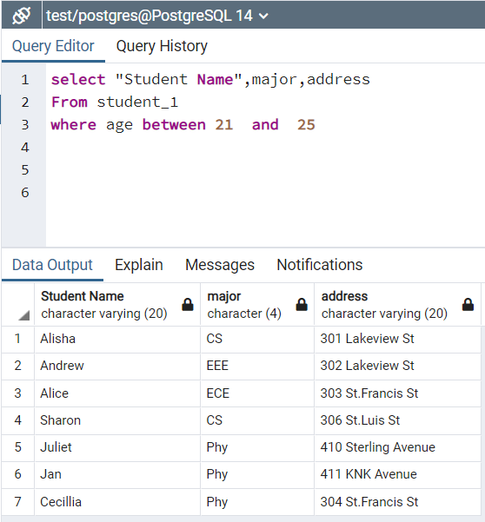
6. List of students between age 21 to 25:
select "Student Name",major,address
From student_1
where age between 21 and 25

Slide 16
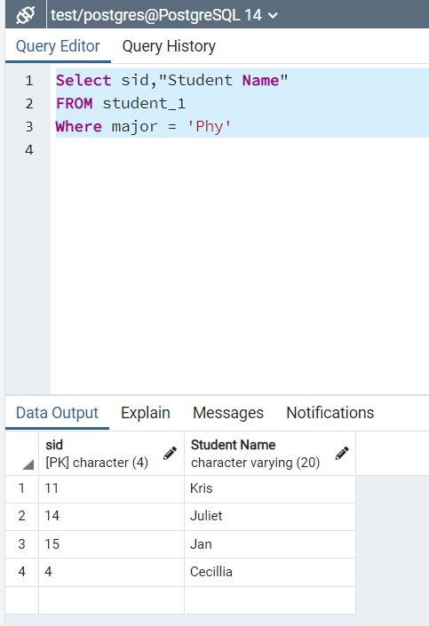
7. Students of physics department:
Select sid,"Student Name"
FROM student_1
Where major = 'Phy'

Slide 17
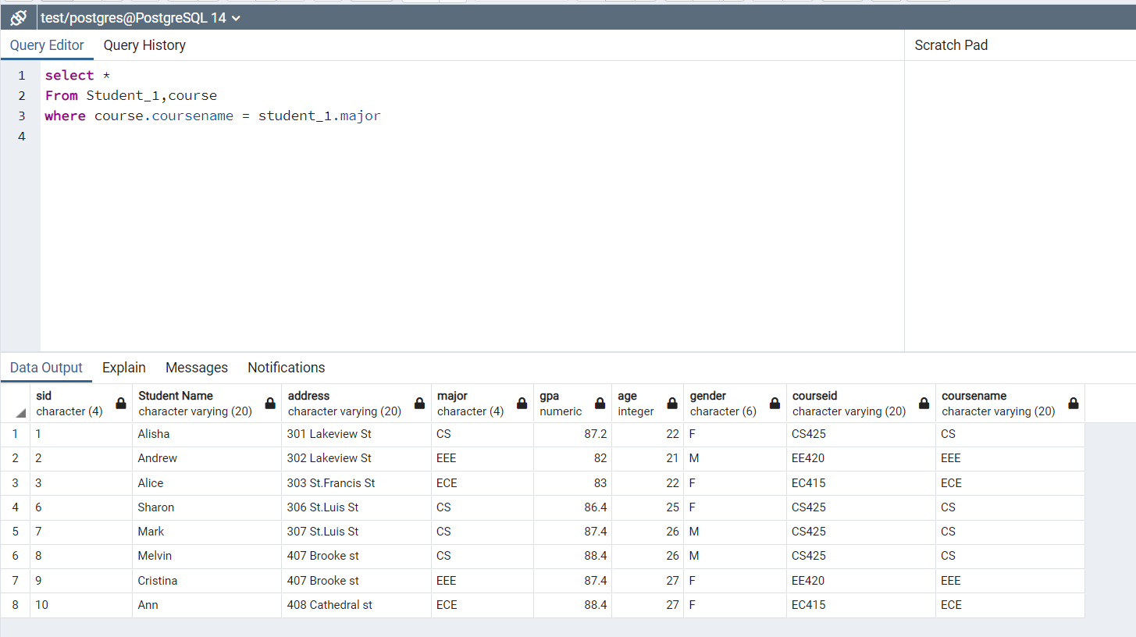
Details of course and students list from student_1 and course relation :
select *
From Student_1,course
where course.coursename = student_1.major

Slide 18
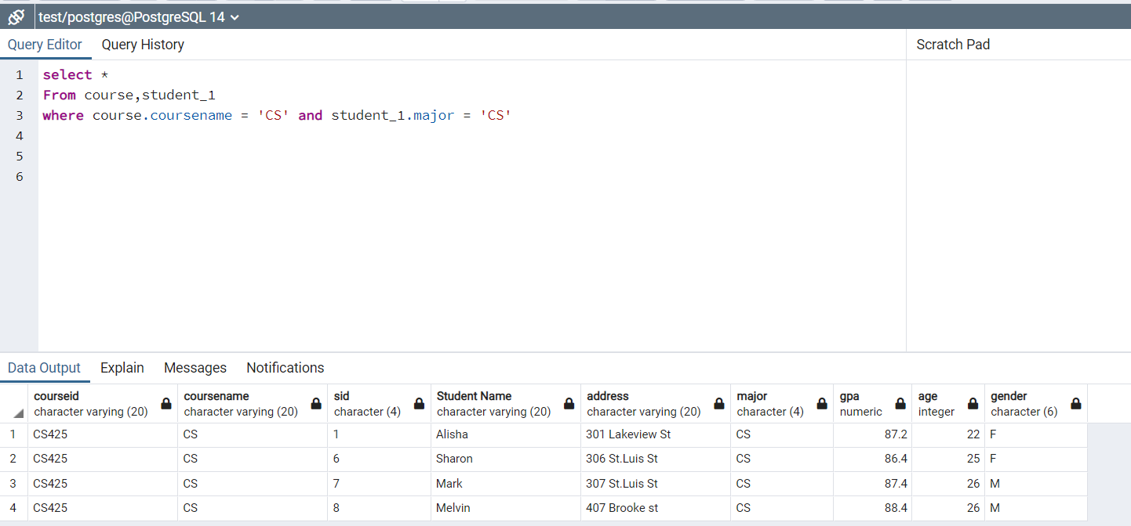
9. Search list of CS students from student_1,course relation:
select *
From course,student_1
where course.coursename = 'CS' and student_1.major = 'CS'

Slide 19
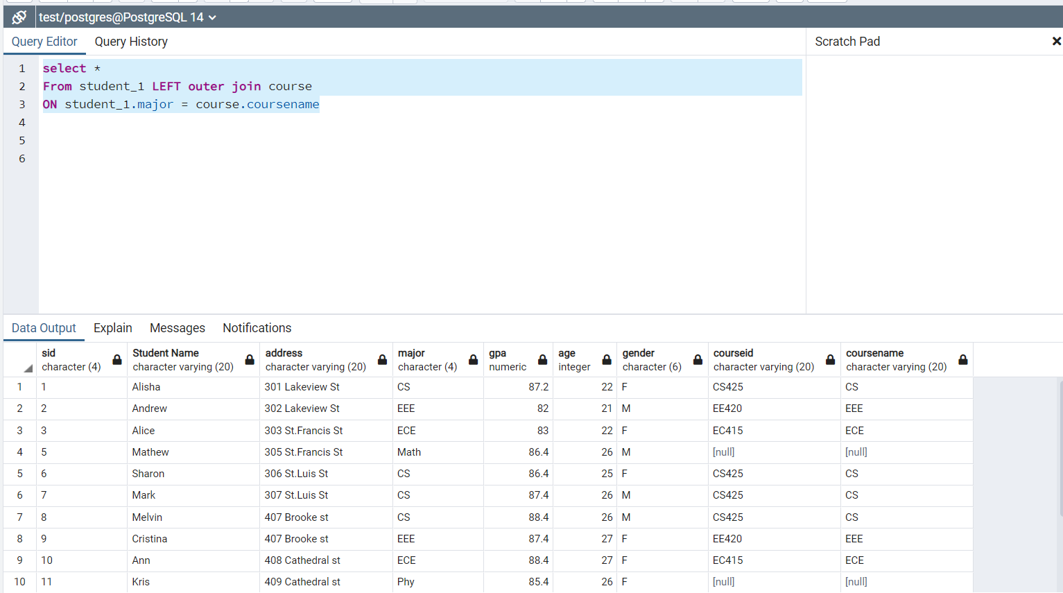
10. Student list whose coursename and major are same:
select *
From student_1 LEFT outer join course
ON student_1.major = course.coursename

